Slide 1
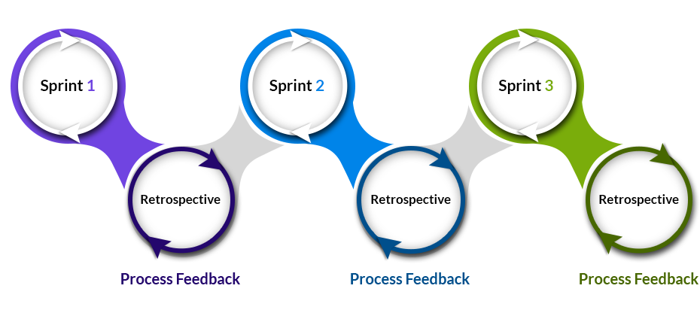
Task 11.2G Sprint 2 Retrospective – Project Demo
Image Link: https://www.profit4sf.nl/wp-content/uploads/2018/11/scrum-process-1.png

Slide 2

Overview of Group Activities
Collaborative/meetings – Timeline:
16/9-
Meeting One
19/9-
Meeting Two
23/9-
Meeting Three
26/9- Meeting Four
Discussing the tasks that the team would complete
(Technology Stack A and B).
Tools to be used for the project were also discussed.
Research topics assigned to each team member:
Cam: Front-end/Programming
Syed: Security
Caitlyn: Databases
Kyria: Back-end Frameworks
Discussed the tasks – 9.1G and 11.2G
Discussed what we had completed for our assigned task for sprint two.
Created this presentation.
Distributed roles for the outstanding tasks to complete the presentation.
Final meeting to complete 11.2G.
Audio for this presentation was recorded.
Started task 11.1G

Slide 3
Issues Faced During the Sprint
Learning programming languages such as Python, C++ and JavaScript.
Understanding the paradigm of these languages.
Difficulty designing UI/UX design.
Struggling to decide which design will attract more audience.
Technical difficulties regarding document collaboration (e.g. MS WORD)
Notes:
One of the most grueling tasks was

Slide 4
Technology Stack a
HTML – Hypertext Markup Language is the standard markup language when creating web pages to assemble a website that is displayed in a web browser. It is a beginner language used to create the structure and content of a web page.
PHP – Hypertext Preprocessor is a general-purpose, open source scripting language. PHP scripting is used to manages dynamic content and databases whilst performing on the server side.
Python – Python is a high-level, open source, object-oriented programming language. Python includes data structures with dynamic typing and dynamic binding and is a scripting language for developing web applications and creating dynamic web content.
MYSQL – MySQL is a open source Relational Database Management System (RDBMS). It uses Structured Query Language (SQL) which is the language used for adding, accessing and managing content in databases
Django – Django is a high-level, open source web framework with a clean and pragmatic design for rapid development. Django is written in Python and design to build complex web applications.
Security – Bandit is a Python tool used to find common security issues in Python code by processing each file, testing then providing a report.
Notes:
Another back-end technology we will be using is Python which is responsible for producing dynamic web content. This will allow our CheckYourCar application to retrieve the client's data stored in our database and return the appropriate information to the user.

Slide 5
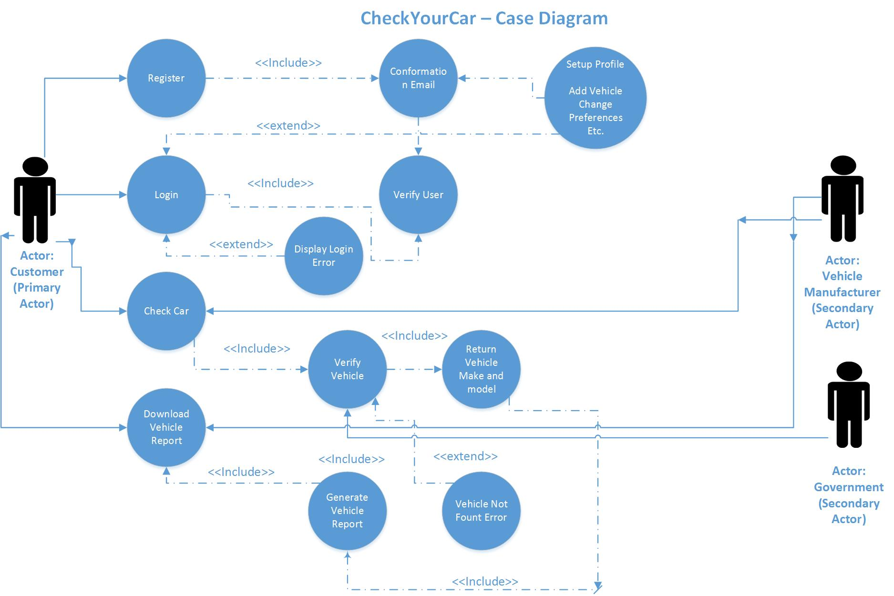
Use Case DIAGRAM – Basic Site Function

Slide 6
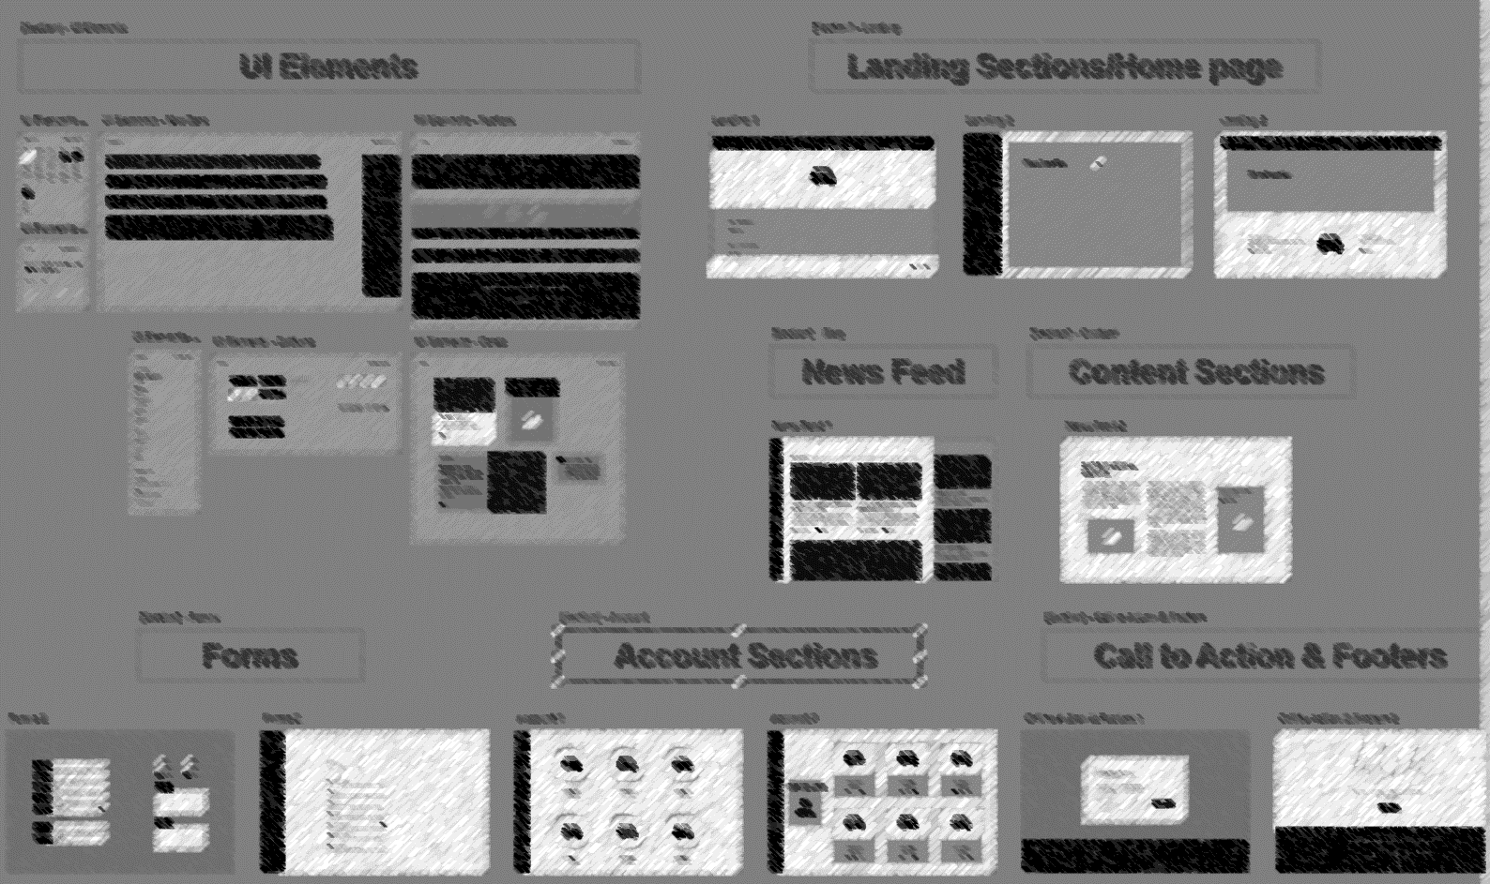
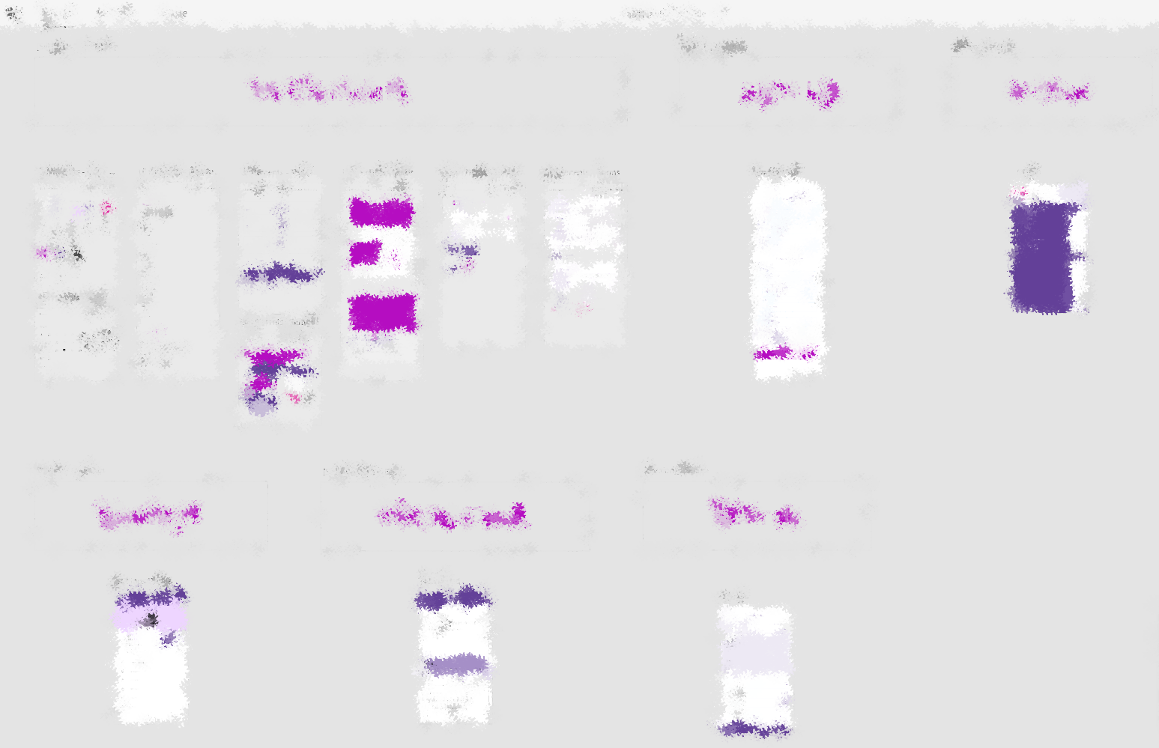
MOCK Designs – UI and UX
Notes:
UX

Slide 7
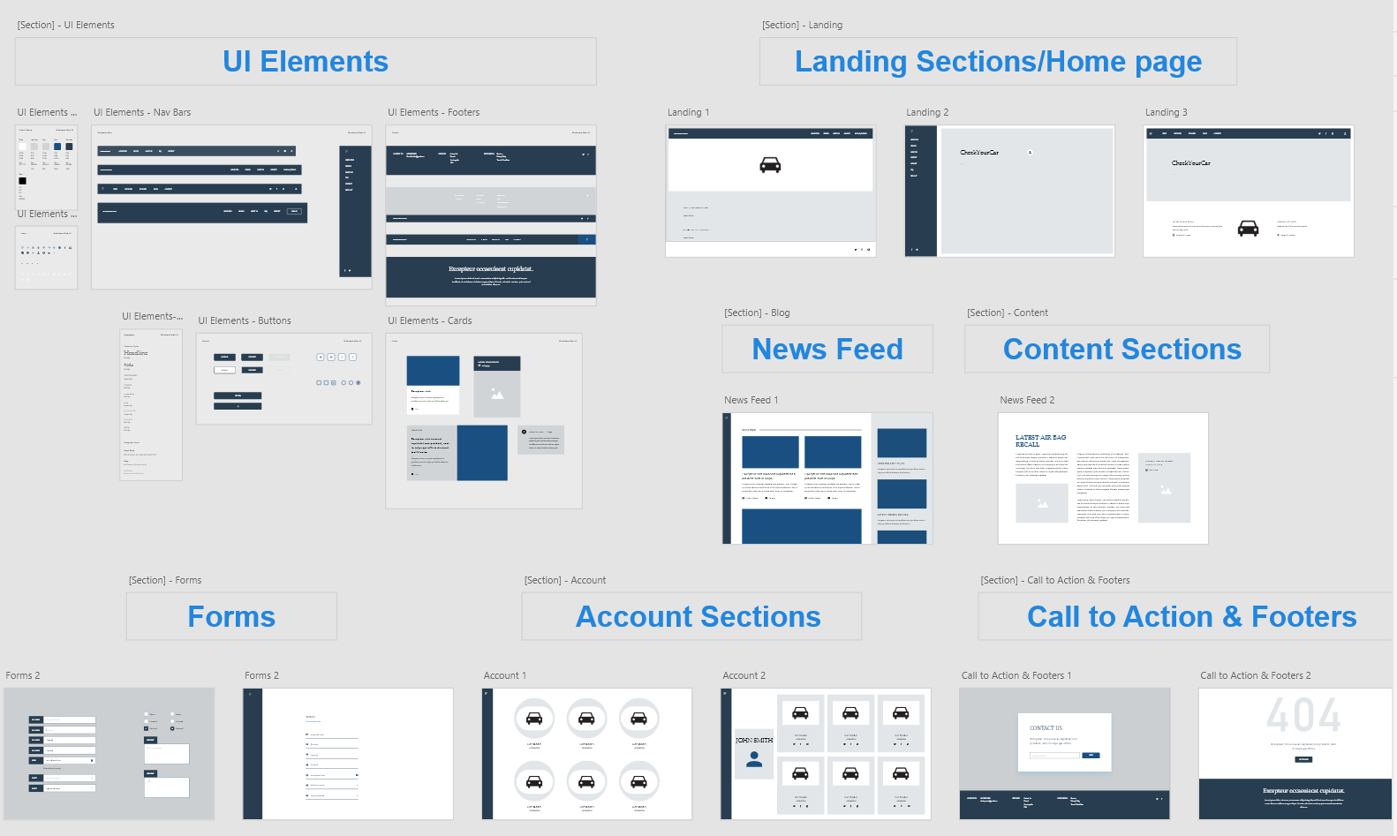

Slide 8
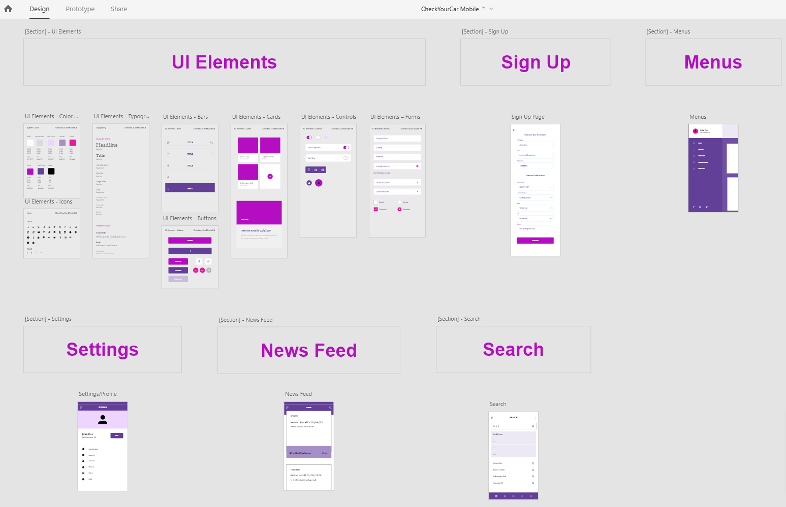

Slide 9
Technology Stack B
HTML – a markup language used to create structure and content for web pages.
CSS – a technology for web pages as it is what creates the visual layout of the page.
JavaScript – a client-side scripting language that allows for complex features on web pages. It is also an interpreted object-oriented programming language.
MariaDB – an open source relational database management system (RDBMS) made by the original developers of SQL.
Express.js – a node.js web application framework used for its specific features in web and mobile applications. Node.js being the framework built for JavaScript.
JavaScript Security - a set of tools able to perform code analysis on the client-side applications and JavaScript provides its own security model to protect from malicious attacks.
Notes:
For our technology stack B, HTML (specifically HMTL5) and CSS are, again, crucial to front-end development of our CheckYourCar service as it sets out the overall structure and appearance of web pages.
We also decided upon using JavaScript to make these pages dynamic, and due to it being a object-oriented programming language it can be used both in the front-end and the back-end development of our website. Having said this, CSS and HTML may still be used to create client-side content.

Slide 10
Difference/similarities between Stacks
Similarities:
Both stacks use HTML and CSS for the main web development language set Web Front-end/Programming Language.
Both of the stacks have good security implementations.
Both stacks are using database technologies and are compatible with the other technologies in their respective stacks.
Differences:
Stack B has fewer technologies used when compared to stack A.
The security implementation In Stack B is integrated in the technologies that are used, whereas Stack A relies on a separate security technology.
Stack A uses a lot of technologies that are easy to pickup and learn, whereas stack B requires more prior knowledge of coding by team members.
Notes:
When deciding on which technologies to prioritize in stacks A and B, we gave an evaluation of their similaraties and differences. This allowed us to identify limitations and determine which technology would be best suited to our needs. We determined that both stacks will utilise technologies that are compatible with each other, and that both HTML and CSS will be used as part of the front-end development. As for the differences, we selected the technologies in Stack A due to advantages such as its ease of security implementation and simplicity.

Slide 11
RISKS
Technology Stack A: Python
Python is beginner-friendly but is difficult to scale
Not as fast as C++ in terms of runtime speed
Implications on maintenance and user experience
Technology Stack B example: JavaScript
Buggy implementations can crash the browser by using heap spraying attacks
Subject to Cross-Site Scripting attacks - these attacks can steal user credentials (such as passwords).
Hence why PHP is used in Stack A
Notes:
There are a number of risks that is to be expected with each technology in Stacks A and B. One of the major risks we identified has to do with Python and its scalability issues. According to our research, we found that Python has a much slower perfomance than scripting languages like C++, which may disrupt user experience. This is also something to consider when looking at the long-term implementation of our CheckYourCar service as the system will become complex and hard to maintain over time. As for technology stack B, we identified that the security risks concerning JavaScript can be overcome by using PHP as this code can be hidden from the browser.

Slide 12
Justifications
HTML and CSS: creates and displays the webpages and is easy to use and implement, being the standard for web design, allows for UI and UX;
PHP: a secure general-purpose language that can be used to make our website dynamic and interactive. Its ease of implementation with HTML, its compatibility with our databasing technology (MYSQL) and its intuitive syntax that is easy for our team due to a lack of coding experience;
MySQL: free to use and is compatible with our chosen programming language of Python and its great deal of community support;
Python: a beginner-friendly language in server-side development, provides complex backend functions and great deal of community support as well as support for backend systems such as Django;
Django: A minimal framework that has ease of implementation with other technologies, such as python and MYSQL.
Bandit: that will help scale and secure our database (e.g. SQL injection attacks, clickjacking attacks, cross-site scripting attacks) and is already offered by Python
Summary
FREE to use
Compatibility
Open-sourced
Community support
Notes:
In this slide we discuss our rationales for our choices of the technologies utilised in our stack A. The team decided upon the sue of HTML and CSS due the fact that they are the general structure for the creation of modern and responsive websites, they are easy to learn can be used to achieve our user interface and user experience goals. PHP was chosen due to is secure implementation of functions into the websites backend, communicating well with HTML and providing dynamic and interactive elements for the site. MYSQL is a free and easy to use software that is compatible with our choice to use python and Python is a beginner friendly language, which is key for our team due to a lack of coding experience. Finally, Django provides us a simple framework that will allow us to prevent common SQL attacks, such as SQL injection attacks, clickjacking attacks and cross-site scripting attacks.
4 main points that lead to our choice of technologies includes:
All of which are free to use

Slide 13
Future Sprints
The next sprint will involve the further development of the defined features that were implemented in sprint two. Additional features will also be discussed.
Additional features include:
Finalizing on which technology stack we will use.
Deciding on the UI/UX design.
Hosting of PHP on a webserver.

